Slide 1
ERICSSON MULTI MEDIATION 6.0
EMM 6.0 OVERVIEW

Slide 2
Agenda
Introduction
Mediation Overview
Hardware
Architecture
GUI

Slide 3
Introduction
Ericsson Multi Mediation is a flexible interface used for handling of the Call Detail Records (CDRs) for further processing in other network elements. A Multi Mediation solution is necessary for Off-line Cost and Credit Control.
Collecting all charging information, making sure it is correct
No data is lost or duplicated.
Sorting the information to ensure each receiving system gets relevant information.
The mediation system converts between the incoming format and protocol to the outgoing format and protocol suiting each receiving system.

Slide 4
Introduction
Manages the charging information through files and processes them after the mobile services were used.
Used for postpaid ,since the services don’t have to be charged in real time.
CDR is a record containing information relating to a single call or session.
Format of the data stored in the CDR is described by a file named ASN.1 (Abstract Syntax Notation).

Slide 5
Agenda
Mediation Overview

Slide 6
Mediation - Overview
MMS-C
Prepaid System
SMS-C
GGSN
Collection
Processing
Distribution
Billing System
SGSN
MSC

Slide 7
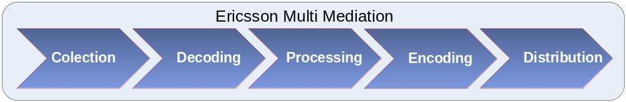
Mediation - Overview
Capítulo 2 – EMM 5.0

Slide 8
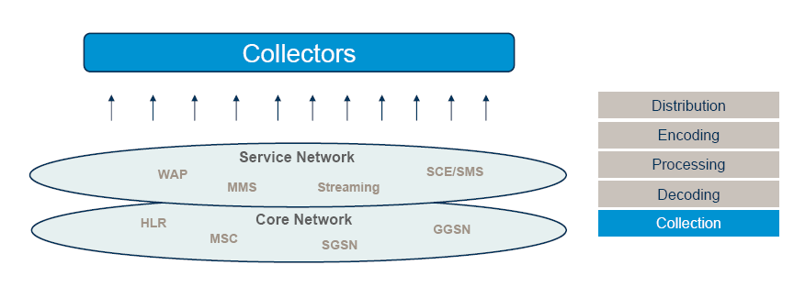
Mediation - Overview
Capítulo 2 – EMM 5.0

Slide 9
Protocols
The following protocols are supported for data collection:
MTP/SFO
MTP/SFI
FTP
SFTP
TFTP
FTAM
Disk
BGw-RPC
Remote Authentication Dial-In User Service (RADIUS)
Oracle® Database
External agent for Log Collection

Slide 10
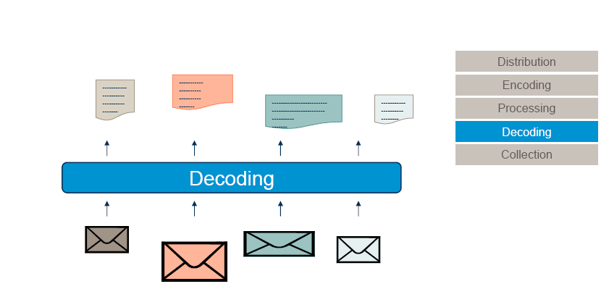
Mediation - Overview
Capítulo 2 – EMM 5.0

Slide 11
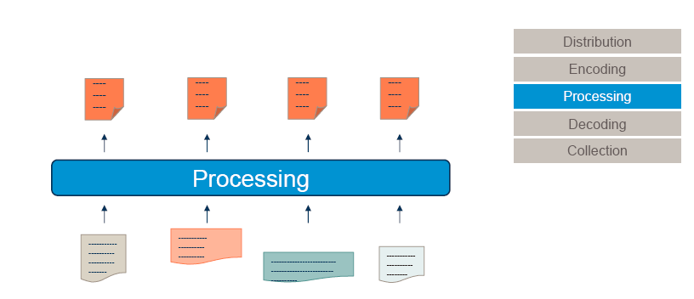
Mediation - Overview
Capítulo 2 – EMM 5.0

Slide 12
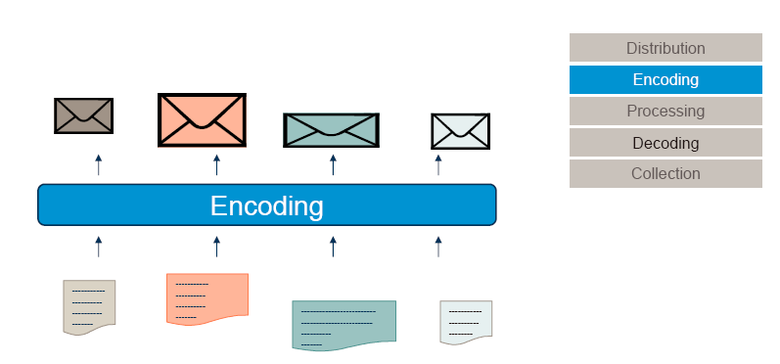
Mediation - Overview
Capítulo 2 – EMM 5.0

Slide 13
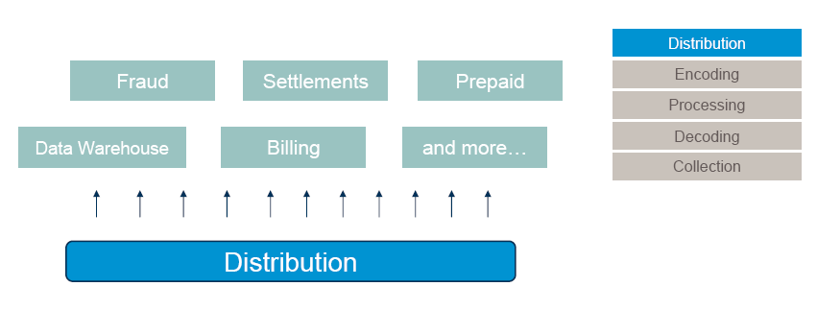
Mediation - Overview
Capítulo 2 – EMM 5.0

Slide 14
Agenda
Hardware

Slide 15
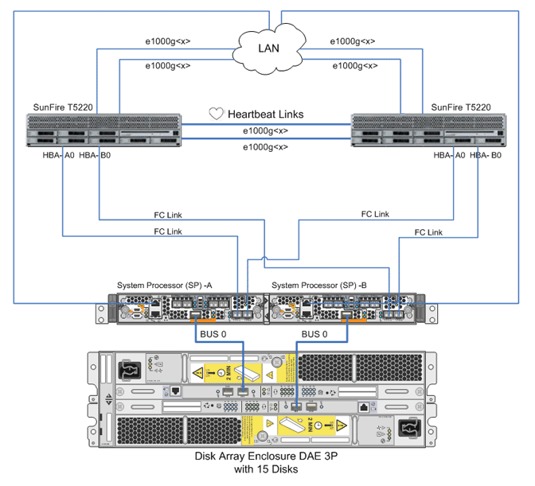
Hardware configuration

Slide 16
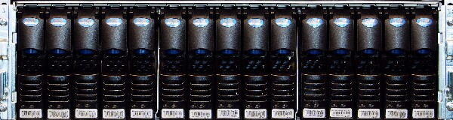
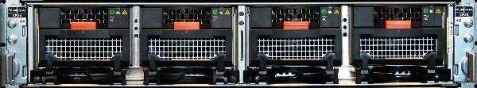

CLARiiON CX4 Platform: CX4
CX4 front
DAE
SPE
SPS

Slide 17
Hardware description
2 Sun Enterprise T5220
  8 CPU eight-core 1165MHz = 64 CPUs
  32 Gb DRAM
  4MB integrated L2 cache per processor
http://www.oracle.com/us/products/servers-storage/servers/sparc-enterprise/t-series/036002.pdf
1 DELL storage EMC CX4
  15*300GB

Slide 18
Agenda
Architecture

Slide 19
Mandatory software
Sun Solaris
MM, media kit,
Sun Veritas Storage Foundation for Sun
Veritas Cluster Server for Sun
Oracle Enterprise Edition

Slide 20
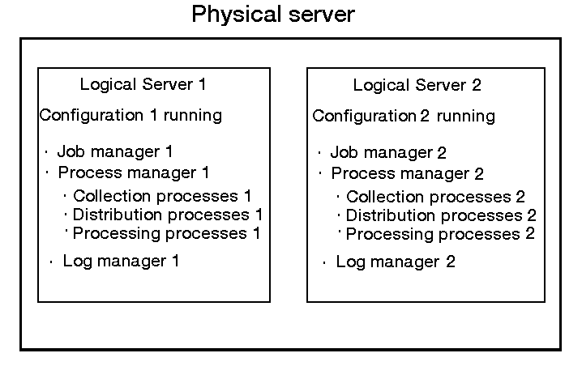
Logical Server
A logical server is an instance of the MM application.
In some implementations, it is needed to use more than one logical server on one physical server.
This means that more than one instance of the MM application would be processing in parallel different configurations on the same physical server
each instance having its own set of processes running. Only one configuration can run on each logical server.

Slide 21


Internal processes
Task dedicated processes
Architecture isolates the different components from external errors
File
Mediation
manager
File Mediation server
Log db
Log
manager
Job
manager
Process
manager
Collector Groups
Distributor Groups
Collection
Processing
Distribution
Notes:
LHS-Ericsson Knowledge transfer
2008-04-30
Ericsson AB 2008

Slide 22

Communication Security
Secure file handling
Job manager
Network element
Business support system
Collection
Processing
Distribution
Mirrored disks
Inbuffer
Outbuffer

Slide 23
EMM6.0 Architecture
File and Event ServerN
GUI
File and Event Server2
File Mediation
Manager (FMM)
Detail record flow
Control flow
Log data flow
File and Event Server1
Oracle
Job
Manager
Process
Manager
fmm
DB
Log DB
Log
Manager
bgw
Distributor
Process
Groups
Collector
Process
Groups
Processing
Component
Processing
Component
Processing
Component
Processing
Component
Processing
Component
Processing
Component
External
Collector
Collection
Component
Processing
Component
Distribution
Component
In Buffer
Out Buffer
Network
Element
Business
System

Slide 24
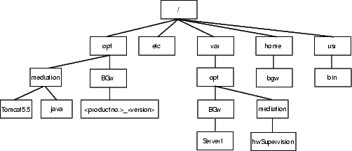
Directory Structure
Configuration data for all resources handled by File and Event mediation
  Directory Structure in MM F&E

Slide 25
FMM directory
opt
BGw
FMM
<productno.>_<version>
Contains the static data and dynamic data for each installed version of File and event Mediation Manager.
This directory and its subdirectories, contains static data only.
config
bin
lib
logs
upgrade
It contains scripts that are used for File and event Mediation Manager.
It contains executables that are used for File and event Mediation Manager configuration. (FMMDbPassword.jar)
It contains the logs generated during FMM Upgrade Procedure.
It contains files used for upgrading File and event Mediation Manager.
database
Contains database specific files (templates for dbca and SQL scripts for tablespaces, users, tables, indexes and views).

Slide 26
Agenda
GUI

Slide 27
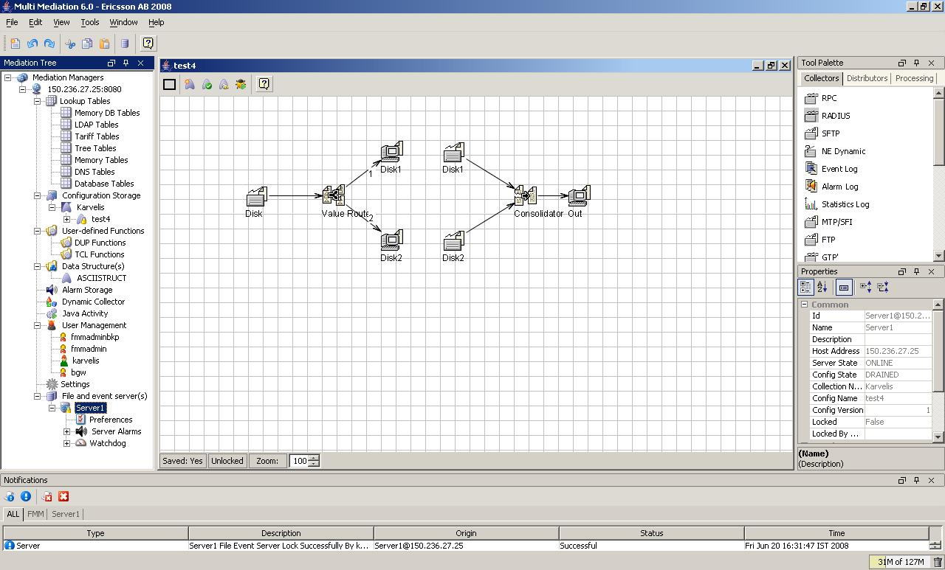
GUI – General View

Slide 28
GUI – Configuration View
Menu Bar
Configuration Area
Toolbar
Configuration Toolbar
Tool Palette
Mediation Tree
Properties Panel
Configuration Status Bar
Notifications Toolbar
Notification Panel
Garbage Collector

Slide 29
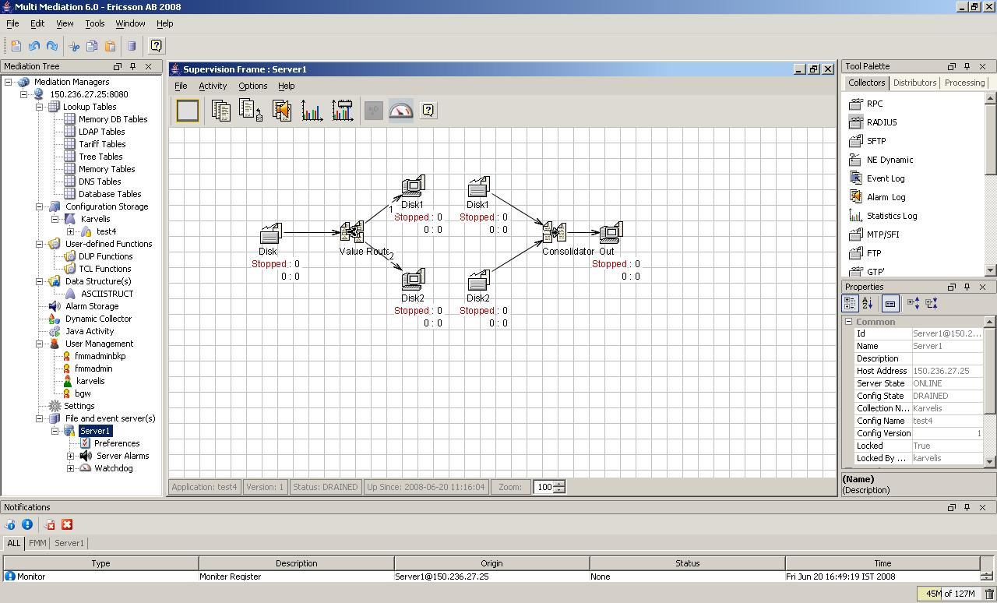
GUI – Supervision View
Supervision Menu Bar
Supervision Toolbar
Supervision Area
Supervision Status Bar

Slide 30
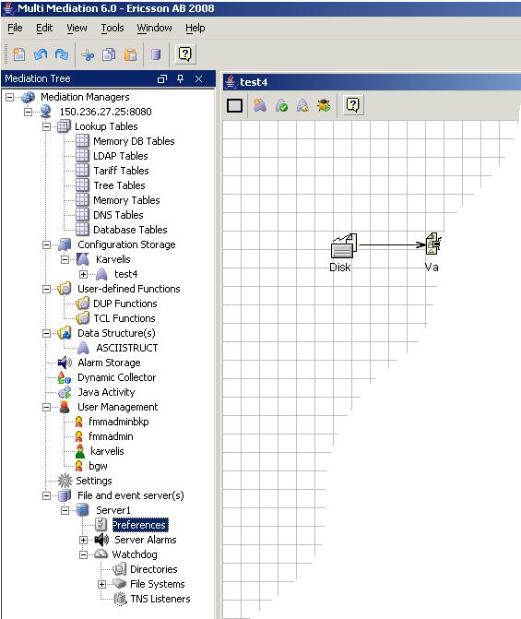
GUI – FMM x Server
Server (Validation/Activation)
Server can still running without FMM.
FMM can still running without a Server (you could work in configuration but you will be not able to Validate the elements or Activate the configuration).
(OBS: Some elements you have to validate to be able to save it, thus you need a server to create this kind of elements – like a lookup table).
FMM
(Validation on Server)
Server

Slide 31
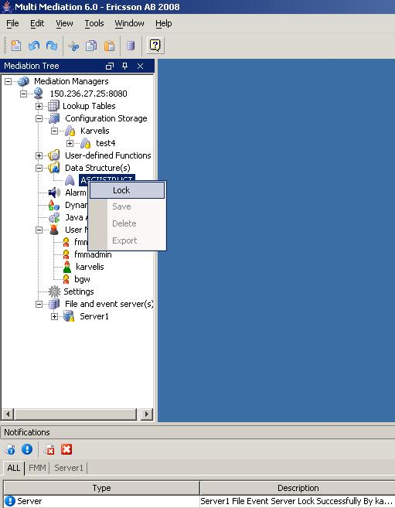
GUI – Lock/Unlock
The Lock functionality is used to ensure that only one user has access to perform operations like, modification or deletion on the selected resources. Bellow you see the list of resources that has lock/unlock functionality:
Lookup Tables.
Configuration Collection.
Configuration.
User-defined functions.
ASN.1.
User-defined and Server Alarms.
Settings.
File and event server.
Lock/Unlock

Slide 32
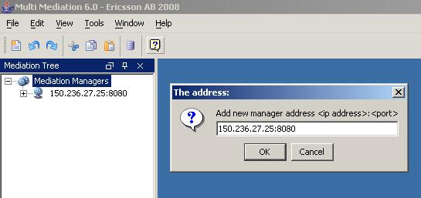
GUI – Mediation Manager
Right click in Mediation Managers
Add Mediation Manager
(see the syntax)

Slide 33
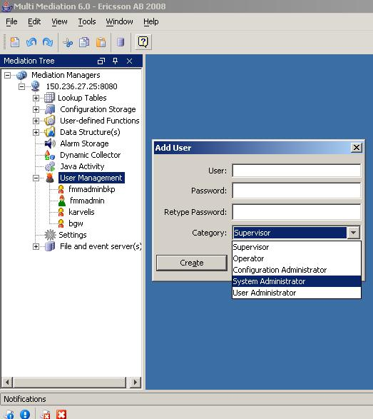
GUI – User Management
You could create a user with the following types of roles:
• Supervisor – monitors running configurations.
• Operator – handles existing configurations, for example, starts and stops configurations and assigns them to nodes.
• Configuration Administrator – works with configurations, for example, creates and maintains configurations.
• System Administrator – works with nodes and instances, for example, adding new nodes or removing nodes that can run File and event servers.
• User Administrator – handles users in the system, for example, adding, deleting users.
Right Click as fmmadmin
to add a user

Slide 34
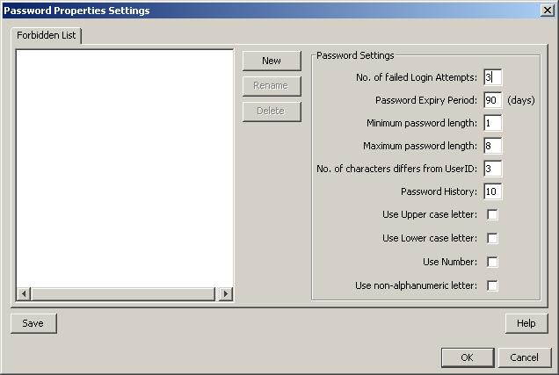
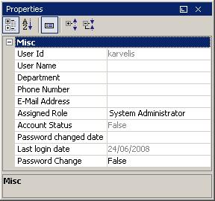
GUI – User Management
User Management
Password Property
User Properties

Slide 35
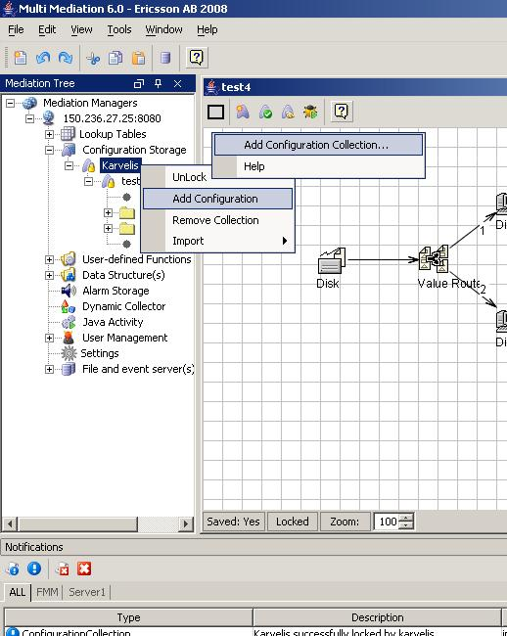
GUI – Configuration Storage
A Configuration Collection can contain zero to many configurations and it must be created before any configuration can be created.
A configuration added by one user is visible to all users who have connected and logged in to the same FMM.
You have to lock a configuration collection to add a configuration and you have to lock a configuration to work in it.

Slide 36
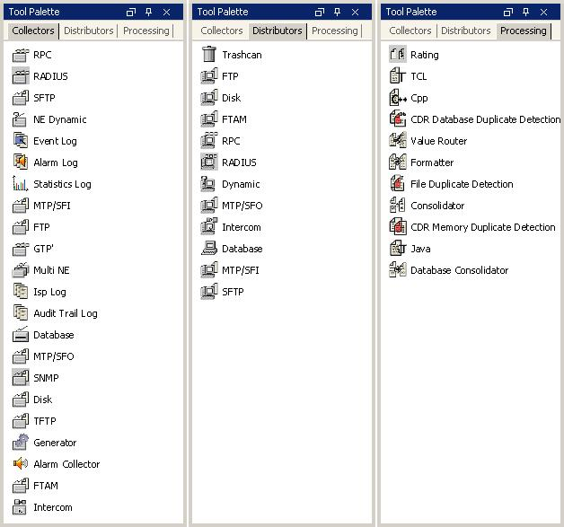
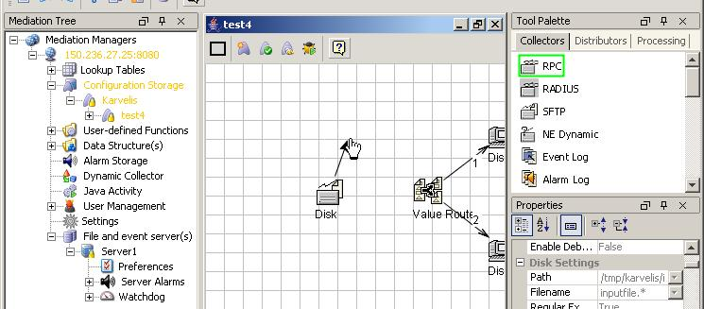
GUI – List of All Nodes
Drag and drop nodes.
Link nodes: cursor in the node center and drag and drop the arrow.
Change properties.
Changes in orange.

Slide 37



Emm configuration in china gprs network components (1)
Collector
Collect CDR files from FTP server or local disk
Distributor
Where CDR files are fetched
Formatter
Transform from one data structure to another

Slide 38



Emm configuration in china gprs network components (2)
Consolidator
Where partial CDRs are combined
Value-router
    Similar to “IF-THEN” statement
Link
Link components above and control data flow

Slide 39
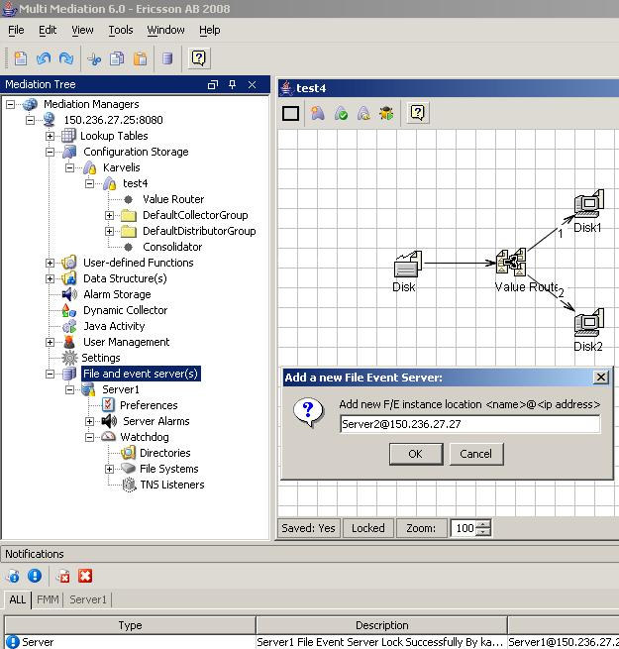
GUI – Servers
Right click in File and event server(s)
Add a file and event server
(see the syntax - <name> must be same as configured in BGw.config file. <ip address> could be any machine ip where you have a bgw server running.)

Slide 40
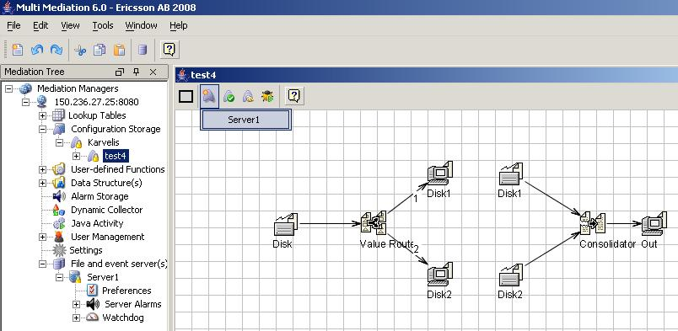
GUI – Activating a Configuration
You must lock the configuration and a server to be able to activate (or validate) a configuration.

Slide 41
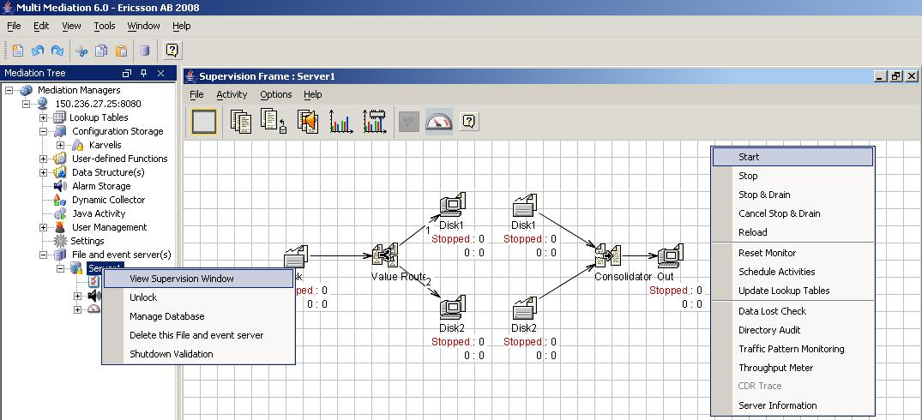
GUI – Starting a Configuration
Right click on the server and click in View Supervision Window.
Right click on the supervision area and click in Start.

Slide 42
Conclusion – Questions & Answers
Questions ?

Slide 43


